Slide 1
Stacks Application: Evaluating Expressions
Write a function to evaluate these expressions:
Infix notation
A + B
(A + B) * C
A * B + C
A + B * C
Maintain a stack S (initially empty)
For each token t:
If t is an operand, push(S, t)
If t is an operator:
pop the top 2 operands p1 and p2 from the stack
push(S, p2 t p1)
Pop the stack to produce the answer
Postfix notation
A B +
A B + C *
A B * C +
A B C * +

Slide 2
Infix to Postfix
Create an empty stack S for operators
Create an empty list L for output
For each token t:
If t is an operand, append(L, t)
If t is a left parenthesis, push(S, t)
If t is a right parenthesis:
pop S until the corresponding left parenthesis is removed
append each popped operator to L
If t is an operator:
repeatedly peek S, pop any operators of high precedence than t and append them to L
push(S, t)
Pop any remaining operators in S and append them to L

Slide 3
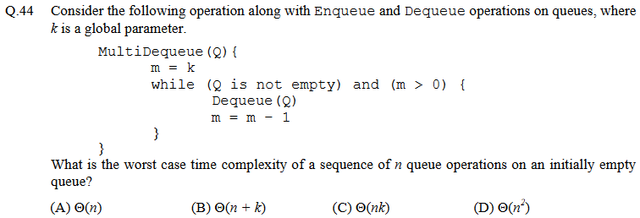
GATE question (CS, 2013)

Slide 4
Interview Question
Consider this infinite 2D grid:
You are given:
the initial point
up() and right() functions
Goal: find the target
Your friend’s solution:
target
initial
D = empty(); // stack/queue
insert(D, initial); // push/enqueue
while(!isEmpty(D)) {
p = delete(D); // pop/dequeue
if(p == target) { return; }
insert(D, right(p));
insert(D, up(p));
}

